Slide 1
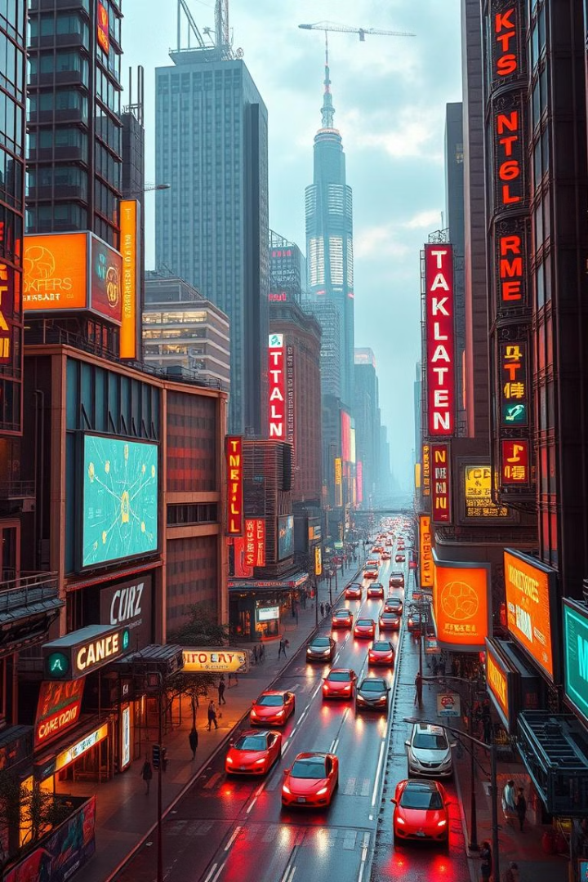

Gemini Landmark Description App
Tourist Experiences with AI. By Byte Blazers: Javvaji Keerthi sri sai, Aishwarya Vacha, Cherukuri Teja Sri, Jupudi Deva Tejaswi, Bonigala Manasa.
by Aishwarya Vacha

Slide 2
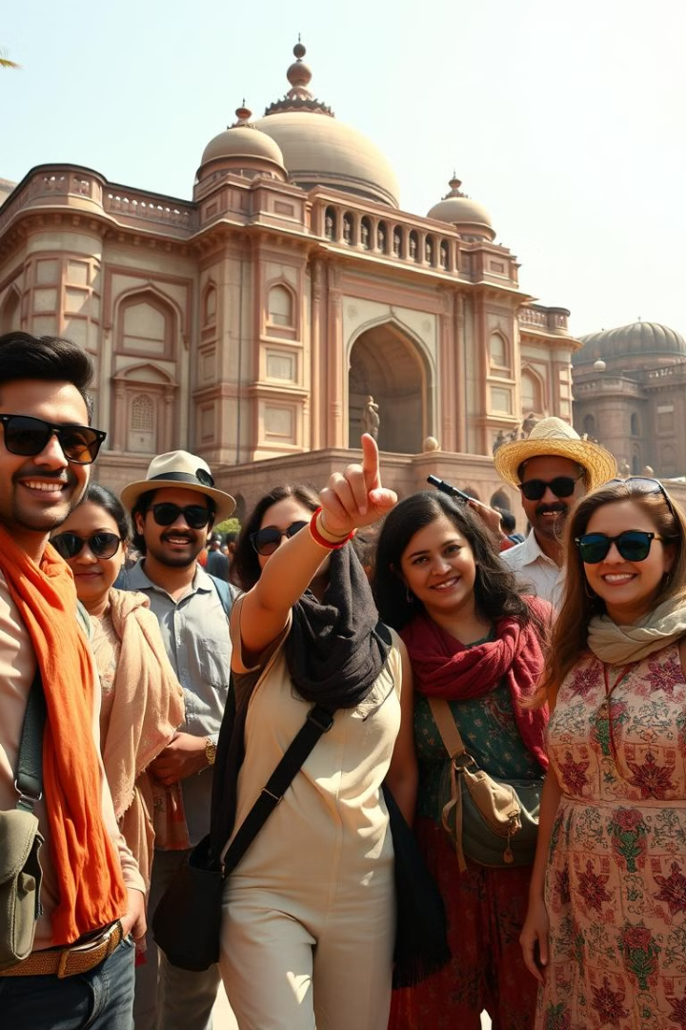
Brainstorming & Ideation
1
Problem
2
Solution
Tourists need dynamic, AI-powered landmark descriptions.
Develop an app using Gemini AI for comprehensive descriptions.
3
Target
Tourists, travel enthusiasts, educators, and those with accessibility needs.

Slide 3
Requirement Analysis
Technical
Functional
Challenges
Python backend. HTML, CSS frontend. UI, API calls.
AI descriptions, recommendations, map integration, information retrieval.
Accuracy, privacy, accessibility, multimodality.

Slide 4
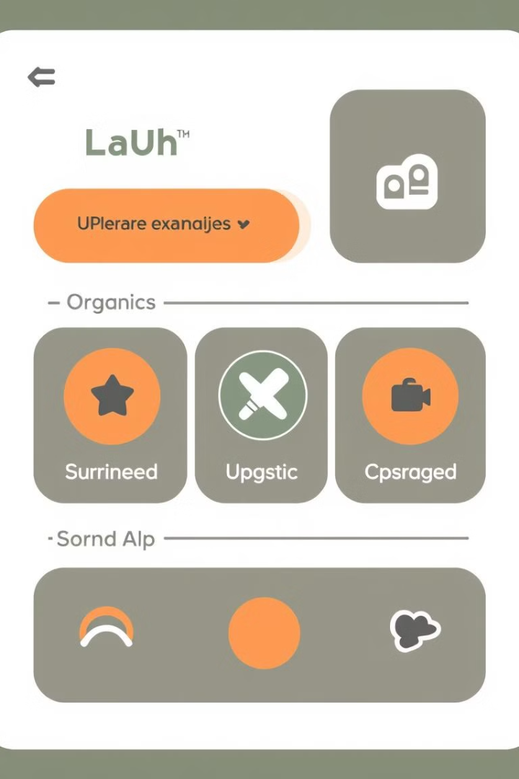



Project Design
User Input
User enters query.
Backend
Processes request.
Display
Displays output.

Slide 5

Project Planning
Task
Team Member(s)
Day 1 (Morning)
Day 1 (Afternoon)
UI/UX Design
Member 1, Member 2
Wireframe
Design Finalization
Backend Development
Member 3, Member 4
API & Database Setup
Data Retrieval

Slide 6
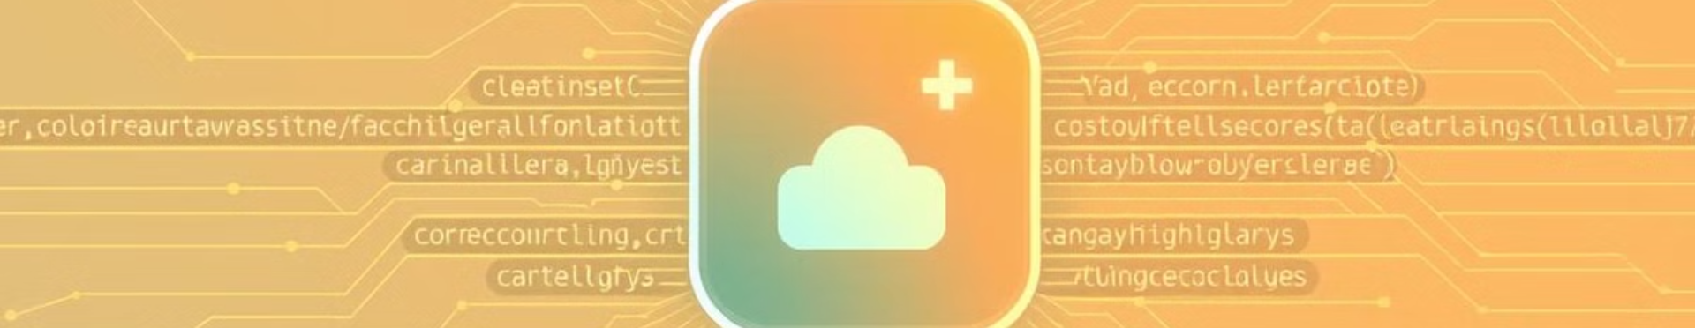



Project Development
Technology
Process
Challenges
Python, UI, API Calls.
SDK install, UI design.
User-friendly interface, data security.

Slide 7

Functional & Performance Testing
Website Launch
User Input
Launches without crashes.
Accepts input, processes request.
AI Fetching
Fetches AI description.

Slide 8
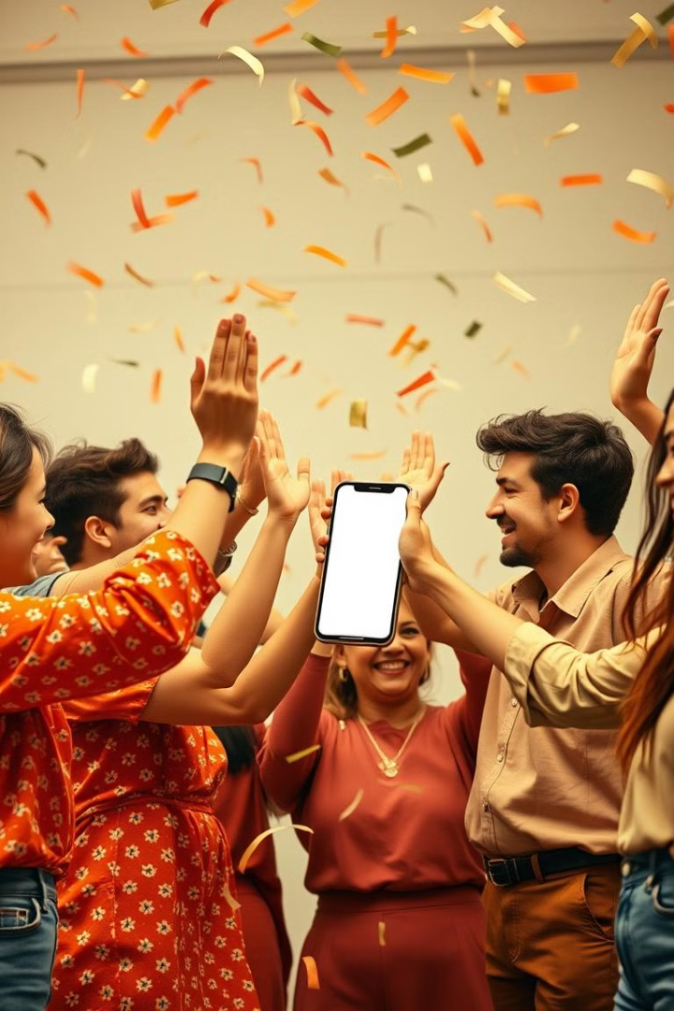
Final Submission
Project Report
Demo Video (3-5 Minutes)
GitHub/Code Repository Link
Presentation

